Slide 1
Photos from Dorothea Lange
Migrant Farm Families portfolio

Slide 2
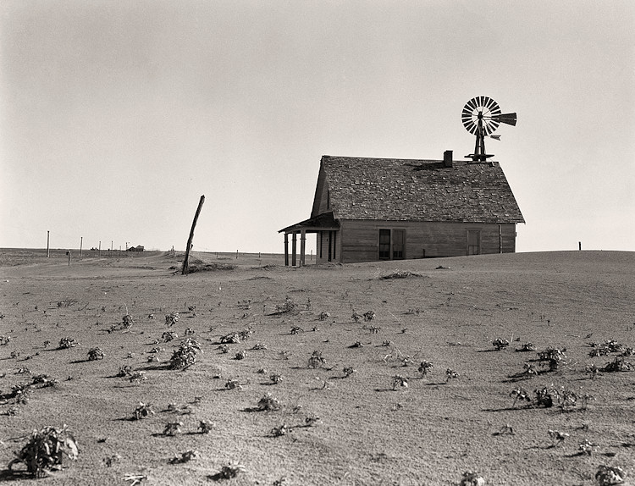

Slide 3
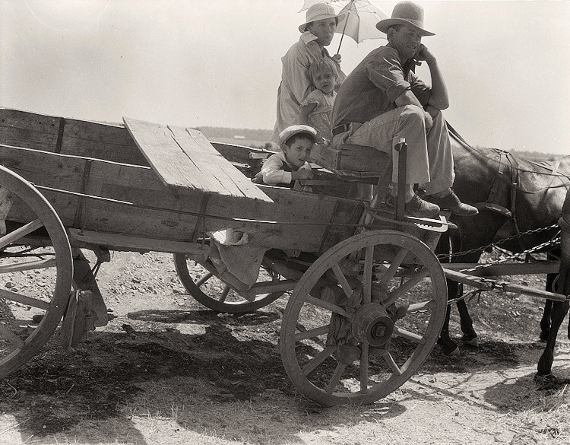

Slide 4
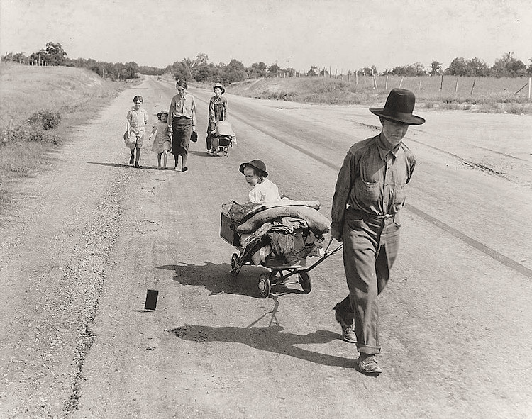

Slide 5
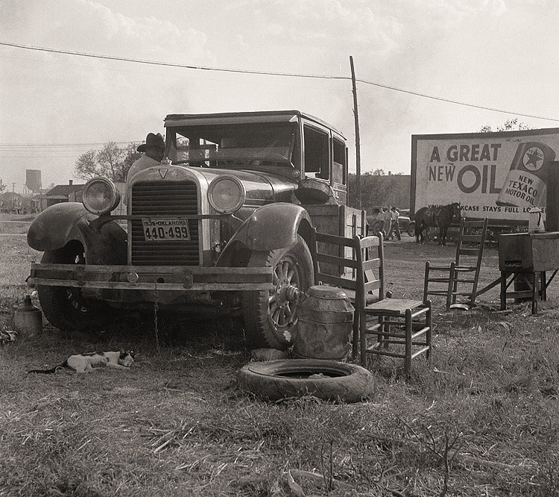

Slide 6
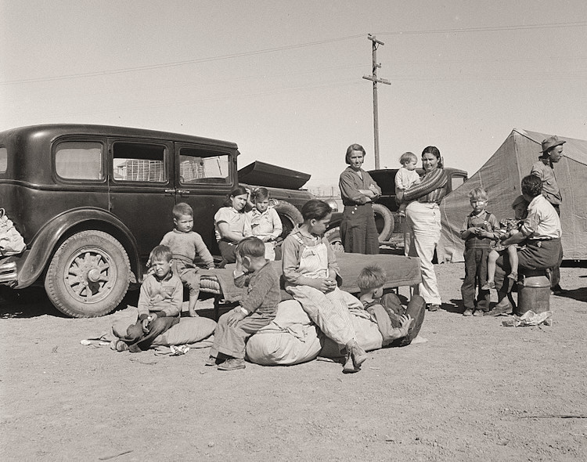

Slide 7
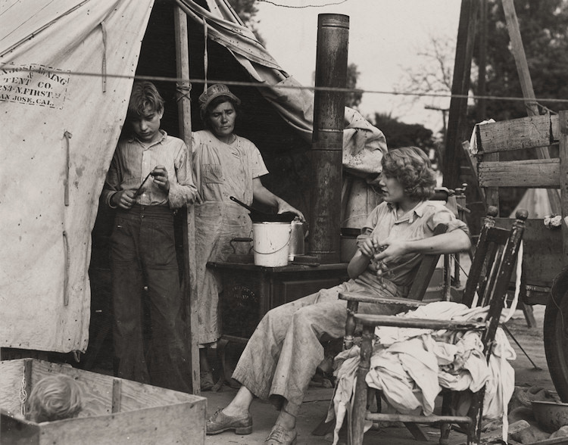

Slide 8
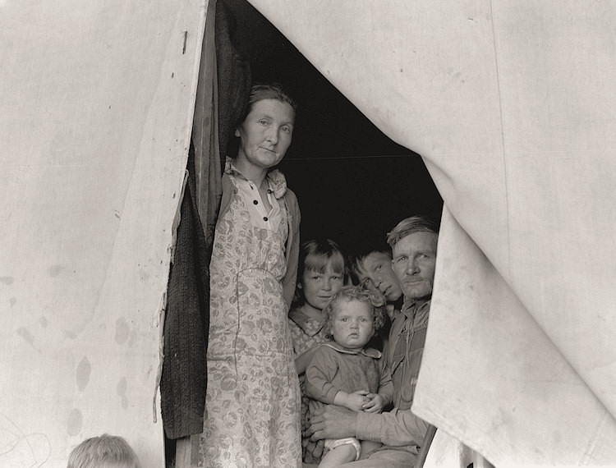

Slide 9
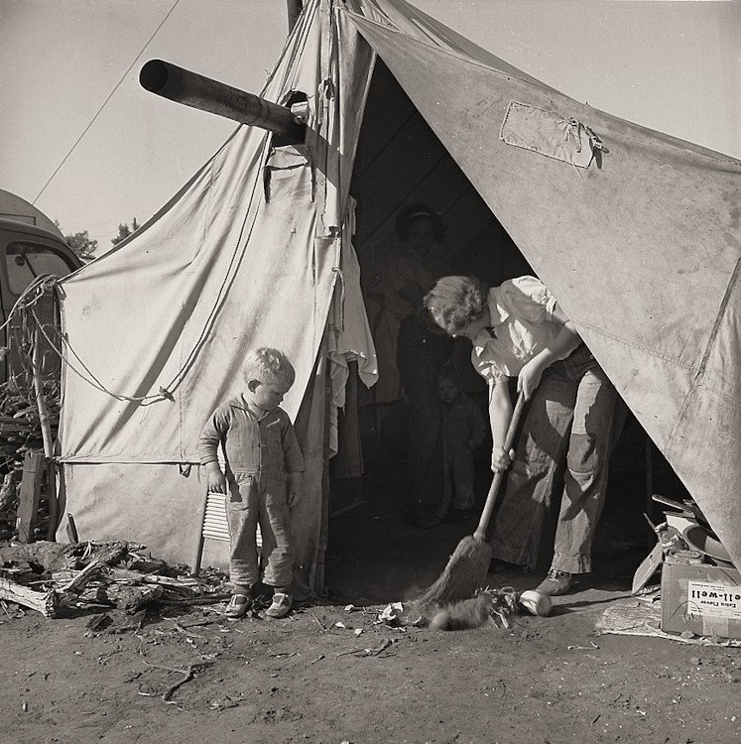

Slide 10
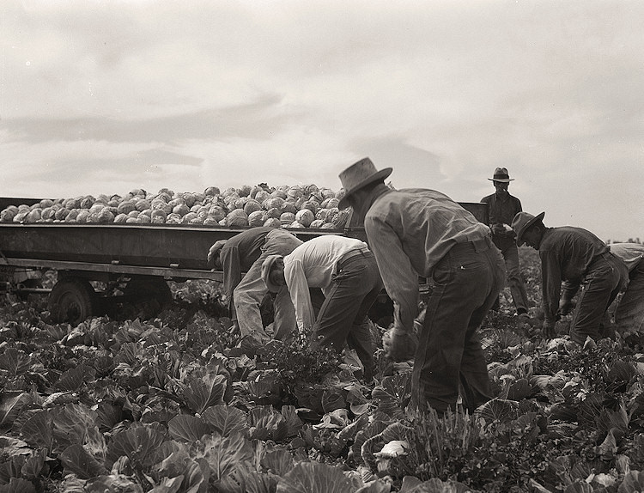

Slide 11
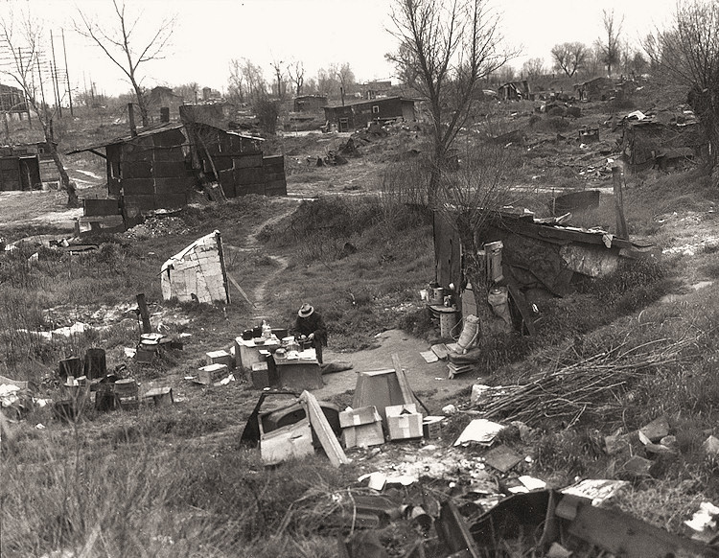

Slide 12
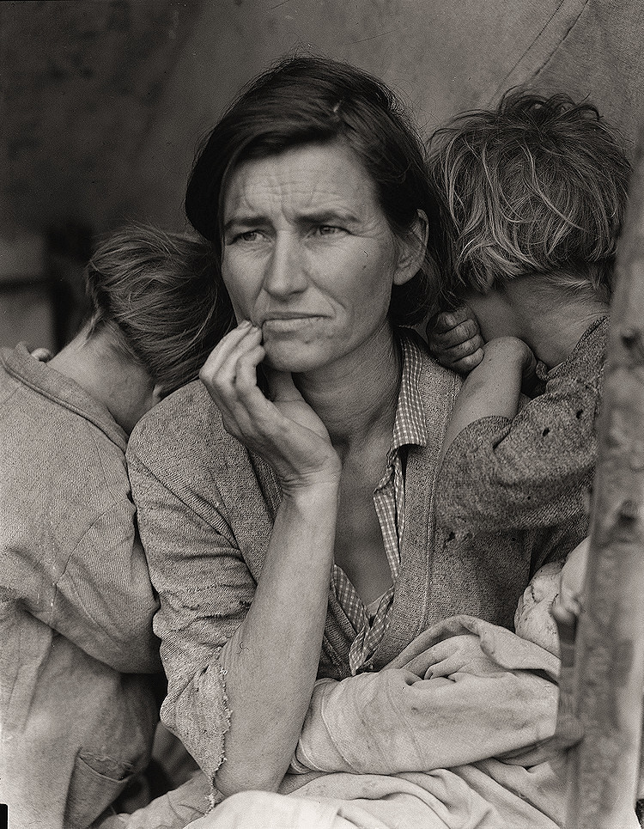

Slide 13
All photos taken from
"The History Place - Dorothea Lange Photo Gallery: Migrant Farm Families." The History Place - Dorothea Lange Photo Gallery: Migrant Farm Families. The History Place, 2012. Web. 02 Nov. 2014. <http://www.historyplace.com/unitedstates/lange/>.

